Slide 2
Mastering the
AI-based Interview
Alan Jones, MUPP ‘89, MBA ‘93

Slide 3
Learning Outcomes
Understand Automated Video Interviews (AVI) as a new format
Understand how job candidates interface with it successfully

Slide 4
My interests and orientation
Overall:
Finding reasons to like AVI’s.
Background:
University career center counselor
Use of reflection questions in work with students
Notes:
https://www.wyspr.co.uk/post/understanding-gen-z-post-ironic-humour

Slide 5
AVI Basics
Overall:
The evaluation of job candidates’ word choice by the Big Five and value/needs theories.
Evidence:
Many vendors are offering these solutions.
Large employers are early adopters.
Controversy around Non-verbals and Facial Action.
U.S. Equal Employment Opportunity Commission (EEOC).
Notes:
https://www.wyspr.co.uk/post/understanding-gen-z-post-ironic-humour

Slide 6
Dynamics of the interview
Issues:
Behavior-based questions
Response time: 3:00 minutes
20-25 minutes, about 6-7 questions

Slide 7
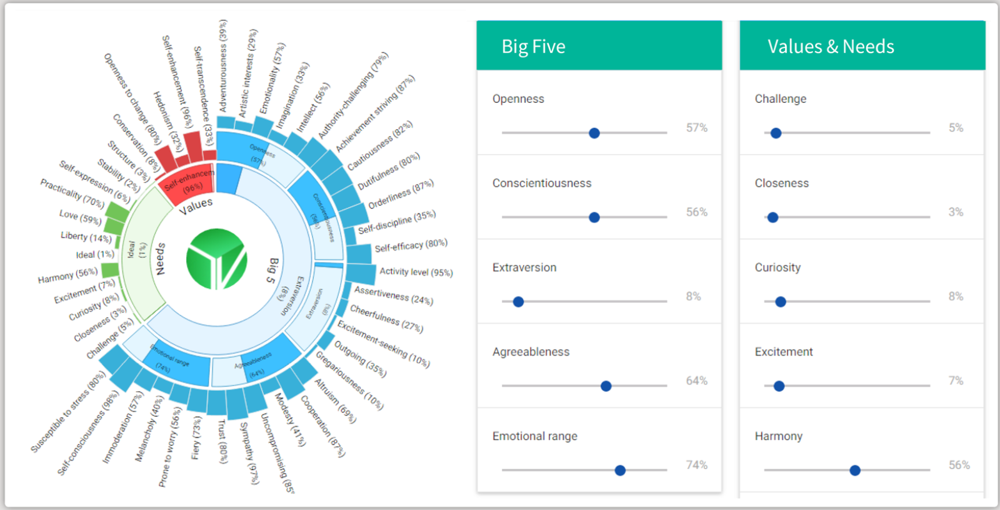

Slide 8
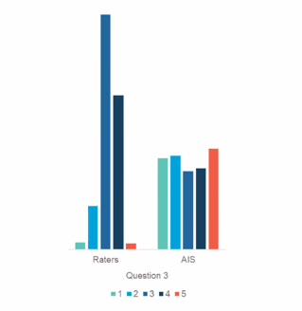
Human Raters vs. AI evaluation

Slide 9
SHIFTING STARTING POINT
-Resumes are too limited to provide information about a candidate’s potential performance in a job.
-AVI’s reveal personality traits and interpersonal skills.
-Video makes it easy to gather data than a written assessment.
-Transcription error rate is below 10%
-Semantic context of a word’s use
Notes:
AI interviews are better for a first stage assessment of candidates than looking over their resumes. Workplace environments are complex and employees need soft skills.

Slide 10
Measurable Competencies
Communication
Team Orientation
Service orientation
Negotiation & Persuasion
Relationship building
Coordination of people & resources
Compassion
Safety & Compliance
Composure
Willingness to Learn
Notes:
https://www.wyspr.co.uk/post/understanding-gen-z-post-ironic-humour

Slide 11
Lack of
Modeling of
Social Conventions
Predicted Ability
-Fewer views by the employer
-Distracted attention & multi-tasking by any reviewers
90-130 seconds is enough time for the algorithm.
-There are declining returns to additional words thereafter.

Slide 12
Meaning-making
-Derive preferences and favorites from reflection.
-Create symbolic language.

Slide 13
Preferences & Favorites
Reflection questions
Positive figure. “Who did you admire?”
Favorite TV shows, websites, magazines
Favorite movie, story
Favorite saying or motto
Early recollections
Favorite music groups/songs
Favorite metaphors
Notes:
https://www.wyspr.co.uk/post/understanding-gen-z-post-ironic-humour

Slide 14
Why sense-making as a strategy?
Metaphorical & Symbolic
Succinct – to fit into 3:00 window
Adds another layer of words
Performative dialogue with oneself
Divergence in stories:
Personal interests offers new ways to make meaning. Moves beyond work & school.
Individual preferences & favorites are easy to recall
More opportunity to improvise responses

Slide 15
Improvisation using Imagination
The use of intuition
second order cognitive thinking (dialogic self)
the improvisation of one’s identity as needed for new circumstances.
Muijen, Langelle, and Meijers (2018). The role of imagination in emergent career agency.
Emergent meaning
Texturizing

Slide 16
Story-telling
-Staying in the story.
-The outcome is secondary.
-Whipsawing one’s account.

Slide 17
The Arc of a Story

Slide 18
Dichotomizing the story enhances it
Emphasizing the high’s and low’s in a story:
Agreeableness, conscientiousness, and extraversion are related to the rising action and HIGH points
Openness and Agreeableness related to autobiographical reasoning in the LOW points (Obstacles)
McLean et. al. (2020) The Empirical Structure of Narrative Identity: The initial big three.

Slide 19
Benefits & Discomforts
Benefits of asynchronous AI:
A safe environment free of social conventions
No need to use personal branding.
What’s up/What down
Short, declarative statements
Less definitive, contextual statements
Try different story-telling models. (e.g., TED talk model)
Discomforts of asynchronous environment
No reciprocity
No dialogue
Notes:
In the Humanities, you can use more ways to make meaning: Cognitive, intuitive, and emotional
Divergence: Humanities teach you to espouse reflectively. Take that stance in your career management, personal branding, and AI interviews

Slide 20
Implications of Format
Is authenticity for a role more significant now?
Career as ‘purpose’ assessed through proxy measurements as they are related to a candidate’s predicted job performance.
Notes:
https://www.wyspr.co.uk/post/understanding-gen-z-post-ironic-humour

Slide 21
Thank you!
See upcoming events, watch past events and recommend topics at go.uic.edu/alumniexchange

